Slide 1

Writing
International Tutoring Center
Supplemental Academic Services
Workshop Series
Cameron Sheehy, M.Ed.
1 |

Slide 2
Agenda
What is Writing?
Challenges to Writing
What is a Prompt?
Rhetorical Situation
What is Revision?
Revision Strategies
Writing Resources
Practicing Self-Compassion
Recap & Next Steps
2 |

Slide 3

Disclaimer
This is an overview.
Each person is different with their own unique background, interests, needs, abilities, and context.
Even the same person can be different today than they were yesterday or will be tomorrow.
3 |

Slide 4
What is Writing?
“Almost all good writing begins with terrible first efforts. You need to start somewhere.”
— Anne Lamott, First Drafts
What do we write?
To-Do Lists
Essays & Reports
Texts & Emails
Journal Entries
Social Media Posts
Movies, Songs, etc.
Why do we write?
To build critical thinking skills
To better understand our ideas
To communicate ideas to others and express ourselves
To document and remember ideas
For fun!
4 |

Slide 5

Challenges to Writing
Anxiety & Perfectionism
Disabilities or Different Abilities
Dyslexia
ADHD
Language Barriers
Lack of Motivation
Lack of Time
Unclear Direction / Unclear Prompt
Reminder: Everyone's different!
5 |

Slide 6
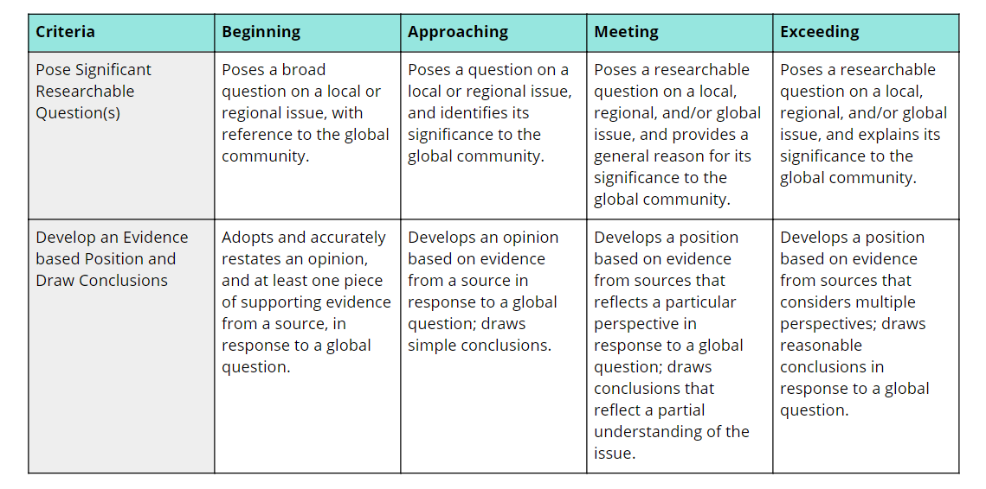
What is a Prompt?
What types of prompts have you encountered?
How can a prompt look?
Some prompts contain multiple paragraphs, while others contain just one sentence (or none at all!).
Some prompts include rubrics, which explain what criteria are needed to succeed on an assignment.
What does a prompt (usually) tell us?
Topic
Audience
Task (Look at action verbs!)
Format / Genre
Other Requirements
(e.g., word or page count, citation style, types of evidence, number of sources, and so on...)
Check Canvas!
6 |
Notes:
cameron

Slide 7
Rhetorical Situation
Read the entire prompt!
Break it
down into the key parts!
Creator
Context
Prompts
Rhetorical Situation
→
Argument
Evidence
→
What is main idea, claim, or thesis?
Why do I choose these sources and not others?
→
Audience
Message
(Topic + Task)
Format / Genre
Bias
Do I follow the conventions or not?
What are my and the audience's assumptions?
7 |

Slide 8
What is Revision?
Researching
Outlining
Revising
Brainstorming
Drafting
Throughout
Writing
Revision
versus
Proofreading/Editing
Adding Ideas​
Adding Ideas​
Fixing Punctation
At the End
Fixing Punctation
Deleting Ideas​​
Deleting Ideas​​
Fixing Formatting
Rewriting Thesis​​​
Rewriting Thesis​​​
Fixing Spelling
Moving Ideas
Fixing Formatting
Changing Words
Fixing Spelling
Moving Ideas
Changing Words
8 |

Slide 9
Revision Strategies
Memory Draft
Rewrite your paper from memory. Then, compare the paper with the memory draft.
Does your original draft clearly reflect what you really want to argue? Should you modify your thesis? Should you reorganize any parts of the paper?
Reverse Outline
Read through your paper and make brief notes about the main point of each paragraph (i.e., a reverse outline).
Use your reverse outline to evaluate the connections between paragraphs and thesis, as well as any unneeded repetition.
Anatomy of a Paper
Use different colors to highlight different elements in your paper (e.g., thesis, topic sentences, evidence).
Review your color-coded paper and determine if you have all the parts you need or if you need to add or delete anything.
Activity #1
Let's practice these revision strategies!
Take out something you are writing for class (or something else). Try one of these strategies and see how it feels.
Then, we will return and discuss our experience.
9 |

Slide 10
Writing Resources
On-Campus Supports
Disability Access Services (https://disabilityaccessservices.northeastern.edu/)
International Tutoring Center
(https://international.northeastern.edu/itc/)
Global Learner Support
(https://gls.northeastern.edu/)
Writing Center
(https://cssh.northeastern.edu/writingcenter/)
Wyzant and Peer Tutoring
(https://cps.northeastern.edu/current-students/tutoring-services/)
Friends and Classmates
Instructors and Teaching Staff
Off-Campus Supports
Dictionaries, Thesauruses, and Translators
Grammarly, Scribbr/QuillBot, etc.
Manchester Academic Phrasebank
Purdue OWL
Use AI as a thinking partner!
Upload the prompt and/or rubric and ask AI to...
(1) clarify topic, audience, task, format/genre, and other requirements before starting and/or
(2) evaluate your work after finishing...
(a) reverse outline my paper
(b) outline the anatomy of this paragraph
(c) give me advice on revising my paper to the rubric
(d) explain if my thesis and claims align
(e) explain if I follow genre conventions
10 |

Slide 11
Practicing Self-Compassion
Be kind to yourself. Everyone struggles with writing!
Anxious Thinking | Growth Mindset Reframing
"I don't understand the assignment—I must not be smart enough or know English well enough." | "I can use the prompt to guide me, as well as strategies and resources to support me."
"There's too much writing—I'll never be able to keep up." | "I can plan my writing schedule in chunks and prioritize the most important sections first."
"I keep getting comments about clarity—maybe I'm not good at writing in English." | "Clarity takes time and practice. I can learn to express my ideas more clearly through revision."
"I'm scared to ask about the assignment because I don't want to look unprepared." | "Professors expect students to ask questions—it shows I'm thinking critically about the task."
11 |

Slide 12
Recap
Check Canvas for the assignment's prompt and/or rubric.
Read them thoroughly, highlighting the rhetorical situation and clarifying uncertainties with your teaching staff.
Use revision strategies throughout the writing process.
Check your work, and consult resources to support you.
Practice self-compassion and reframe your thinking.
Any Questions?
12 |

Slide 13
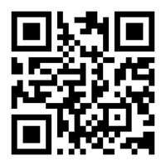
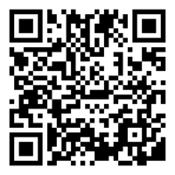
Next Steps
Book a 1-on-1 Tutoring Appointment!
View our tutors' schedules and book by using the QR code or by visiting https://web.penjiapp.com/communities/northeastern/itc/
Attend an Upcoming Workshop!
See our upcoming workshops by using the QR code or by visiting https://international.northeastern.edu/itc/workshops/
13 |
Notes:
Cameron

