Slide 1

Teamwork
International Tutoring Center
Supplemental Academic Services
Workshop Series
Cameron Sheehy, M.Ed.
1 |

Slide 2
Agenda
What is Teamwork & Collaboration?
Challenges to Teamwork & Collaboration
Emotional Intelligence
Effective Meetings Strategies
Teamwork & Collaboration Resources
Practicing Self-Compassion
Recap & Next Steps
2 |

Slide 3
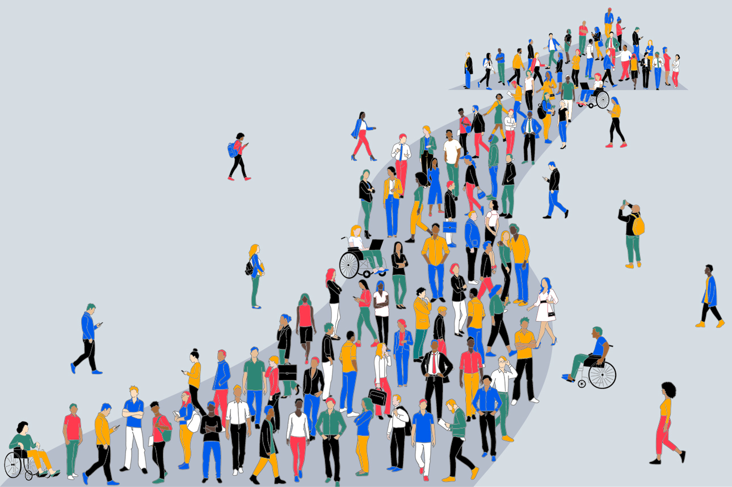
Disclaimer
This is an overview.
Each person is different with their own unique background, interests, needs, abilities, and context.
Even the same person can be different today than they were yesterday or will be tomorrow.
3 |

Slide 4
What is Teamwork & Collaboration?
"Alone we can do so little; together we can do so much."
— Helen Keller
Where do we work on teams?
In the Classroom
In the Workplace
During Meetings
On Projects
Playing Games or Sports
With Family and Friends
Why is teamwork important?
To learn from other and gain new perspectives
To increase productivity and effectiveness
To enhance problem-solving and creativity
To improve communication
To build deeper relationships with others
For fun!
4 |

Slide 5

Challenges to Teamwork & Collaboration
Bias
Disabilities or Different Abilities
Differing Cultural and Linguistic Backgrounds or Personalities
Classroom or Company Culture
Bureaucracy and/or Hierarchy
...and many more!
Reminder: Everyone's different!
Good Teamwork's Foundation:
Emotional Intelligence
5 |

Slide 6
Emotional Intelligence
Bias Awareness
Golden rule of working with others: First, you can manage yourself. Then, you can manage your environment. Only after that should you begin to manage others.
Be aware of your own biases (https://implicit.harvard.edu/implicit/takeatest.html; e.g., confirmation bias, halo effect).
To be a leader, think how to serve those on the team (not just your technical skills), clearly explain the why behind your bigger goal, build connections and network, and spend time wisely on what needs to get done.
Self-Regulation Strategies
Listen to understand, and check your understanding through honest, open, and direct dialogue.
Don't judge people; judge their actions.
Show appreciation for others' actions, like their kindness, hard work, and creativity.
If possible, end on a positive note.
If you need time and space, find a way to get it, calm yourself down, and think things over before responding.
Admit when you're wrong and don't know or understand something. (It's ok!)
6 |

Slide 7
Effective Meeting Strategies
What strategies do you use?
Have a Goal
Define what is success for the meeting. Send out agenda before.
Assign Roles/Tasks
A note-taker (AI or not) is always necessary. Have revolving roles.
Set the Tone
Agenda, meeting norms, networking, communication styles.
Distribute Labor
Eisenhower Matrix; ask and decide what is fair. Use a "parking lot."
Decide as a Group
Group consensus, group input, group recommendation.
Follow Up
The note-taker should distribute notes and next steps after.
Handle Challenges
Talk things out with your team. Escalate up if necessary.
Project Dashboards
Asana, Trello, Teams, Notion, Spreadsheet, a shared doc.
7 |
Notes:
Have an agenda. Have a definition of success for the meeting. Be proactive rather than reactive for planning and time management.
Have revolving roles in recurring meetings is a good way to create engagement (note taker, facilitator, connector, question person, etc.). Ask participants what they want to work on then delegate tasks accordingly (new project or part of an existing project) and be clear about viability.
When managing up, always come with a solution to whatever problem you have. Present options with an informed choice.
Contact an instructor or supervisor if you cannot figure things out yourself.
Asana, Trello, Teams, Notion, Smartsheet, Spreadsheet, …?
People, Perspective, Position to use structure and form (genre conventions) to your advantage in professional communication; Three ways to make decisions in a group include: group consensus on choice, group input to leader who makes the choice, and group recommendation for leader to take with them to whoever makes the choice. Come with solutions. Some other strategies include: focus on people’s behavior and respond accordingly with group memory (e.g., meeting notes), create a “parking lot” to table and return to less urgent ideas later on, state what is happening and ask why or where to go from there as a group, use the boomerang to send thequestion back out, and always keep goals clear.
Prepare, Conduct, Follow Up to host productive meetings. What makes a successful meeting is clear goals, setting the tone upfront (e.g., send an agenda, create meeting norms), your own decision process, and understanding group dynamics.
After a meeting, follow up and send a summary to participants(i.e., what decisions were made and what tasks are due) within a day or so. Then, reflect on the meeting and make decisions about who needs to be talked to or what other things need to be done to run an effective meeting the next time. Have explicit conversations with team members about communication styles and preferences.

Slide 8
Teamwork & Collaboration Resources
On-Campus Supports
Office of University Equity and Compliance (https://ouec.northeastern.edu/)
Disability Access Services(https://disabilityaccessservices.northeastern.edu/)
ITC (https://international.northeastern.edu/gss/tutoring/)
Global Learner Support (https://gls.northeastern.edu/)
Writing Center (https://cssh.northeastern.edu/writingcenter/)
OSCCR (https://osccr.sites.northeastern.edu/)
Office of Global Services (https://international.northeastern.edu/ogs/)
We Care Office (https://we-care.studentlife.northeastern.edu/)
Student Handbook (https://catalog.northeastern.edu/handbook/)
Friends and Classmates
Instructors and Teaching Staff / Academic Advising Staff
Activity
Let's explore some teamwork and collaboration resources!
Browse one (or more) of these supports.
Share your own resources in the chat!
8 |

Slide 9
Practicing Self-Compassion
Be kind to yourself. Everyone struggles with teamwork and collaboration!
Anxious Thinking | Growth Mindset Reframing
"I'm nervous about group work because I don't know how to contribute the 'right' way." | "Every group has different needs—if I communicate directly, we can figure it out."
"We come from different cultures, so I worry we won’t understand each other's work styles." | "Working across cultures takes patience, and I can learn a lot by being open to different approaches."
"I'm afraid to take the lead because I don't want to be responsible for others' mistakes." | "Leadership can be shared, and I can support the group by helping us stay organized and on track."
"I feel like I'm doing more than others, but I don't want to create conflict." | "I can ask the group to review roles so we can balance the workload together."
9 |

Slide 10
Recap
Reflect on your own biases and ability to self-regulate.
Communicate openly, honestly, and directly with teammates.
Prepare for meetings with a clear goal and agenda.
Assign roles/tasks by distributing labor and follow up.
Consult teamwork and collaboration resources.
Practice self-compassion and reframe your thinking.
Any Questions?
10 |

Slide 11
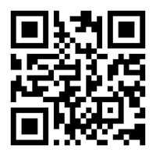
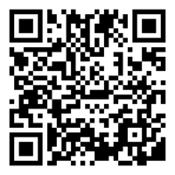
Next Steps
Book a 1-on-1 Tutoring Appointment!
View our tutors' schedules and book by using the QR code or by visiting https://web.penjiapp.com/communities/northeastern/itc/
Attend an Upcoming Workshop!
See our upcoming workshops by using the QR code or by visiting https://international.northeastern.edu/itc/workshops/
11 |
Notes:
Cameron

