Slide 1

Study Skills
International Tutoring Center
Supplemental Academic Services
Workshop Series
Cameron Sheehy, M.Ed.
1 |

Slide 2
Agenda
Challenges to Studying
Managing Assignment Anxiety
Studying Strategies
Note-Taking Strategies
Studying Resources
Practicing Self-Compassion
Recap & Next Steps
2 |

Slide 3

Disclaimer
This is an overview.
Each person is different with their own unique background, interests, needs, abilities, and context.
Even the same person can be different today than they were yesterday or will be tomorrow.
3 |

Slide 4

Challenges to Studying
Anxiety (& Perfectionism)
Disabilities or Different Abilities
Distractions
Unclear Direction
Lack of Motivation
Lack of Time
Reminder: Everyone's different!
4 |

Slide 5
Managing Assignment Anxiety
Before
During
After
Read syllabi and add important dates to your calendar.​
Create a study plan and start on assignments early.​
Pay attention in class and attend office hours and/or review sessions.​
Use tutoring services!​
Visualize a successful outcome, and focus on what you can do in the moment.​
Practice mindful breathing and other grounding techniques.​
Practice self-compassion and affirm yourself: "This is just a test. I studied my best, and I know the material."​
Identify what is in your control. Think about what you can do for the next assignment.​
Reframe how you think about assignments. Grades are just one part of feedback. ​
Seek additional feedback from your teaching staff.
Find strategies here!
5 |

Slide 6
Studying Strategies
What strategies do you use?
Improving Memory
Try not to cram! Stick to a study plan, and be sure to find time for eat, exercise, and sleep.
Be honest with yourself while studying.
Create mnemonics (e.g., acronyms, rhymes, etc.).
Study with others, test yourself, teach to someone else (or even yourself), take notes, alternate topics, use tutoring, find materials online (e.g., YouTube videos), or use AI as a study assistant.
Improving Focus
Use time management and productivity strategies. Have a goal/purpose. Find strategies here.
Participate in class discussions.
Listen to music, use a fidget toy, doodle, chew gum, or other concentration techniques.
Take a walk or other strategic breaks.
Join a study group or use accountability times.
6 |
Notes:
cameron

Slide 7
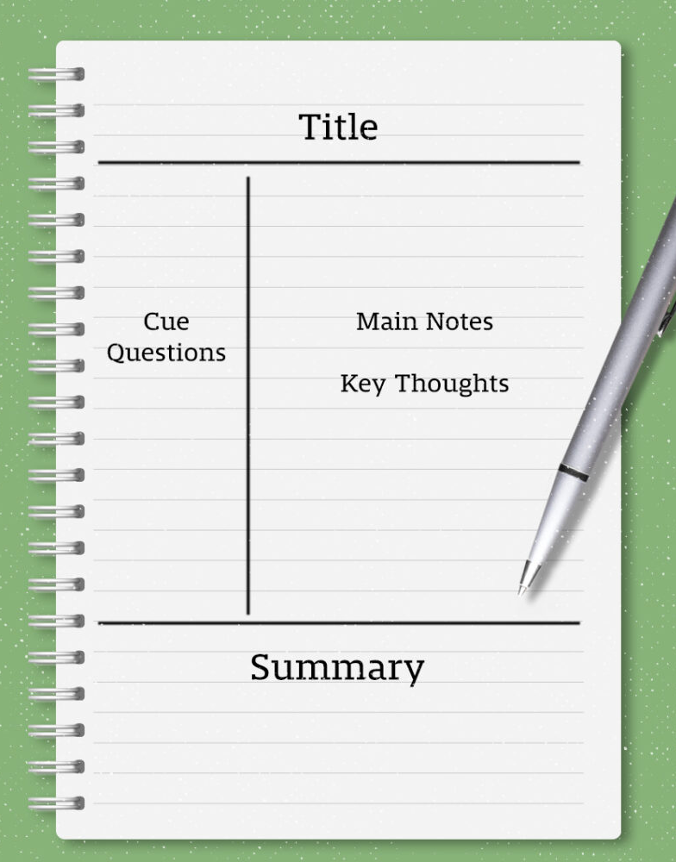
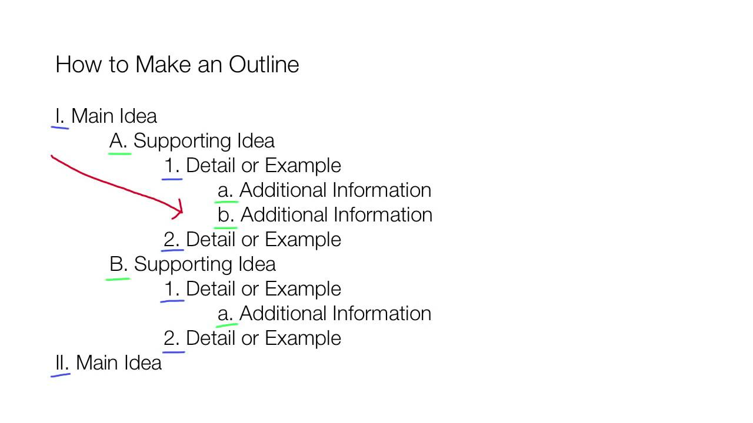
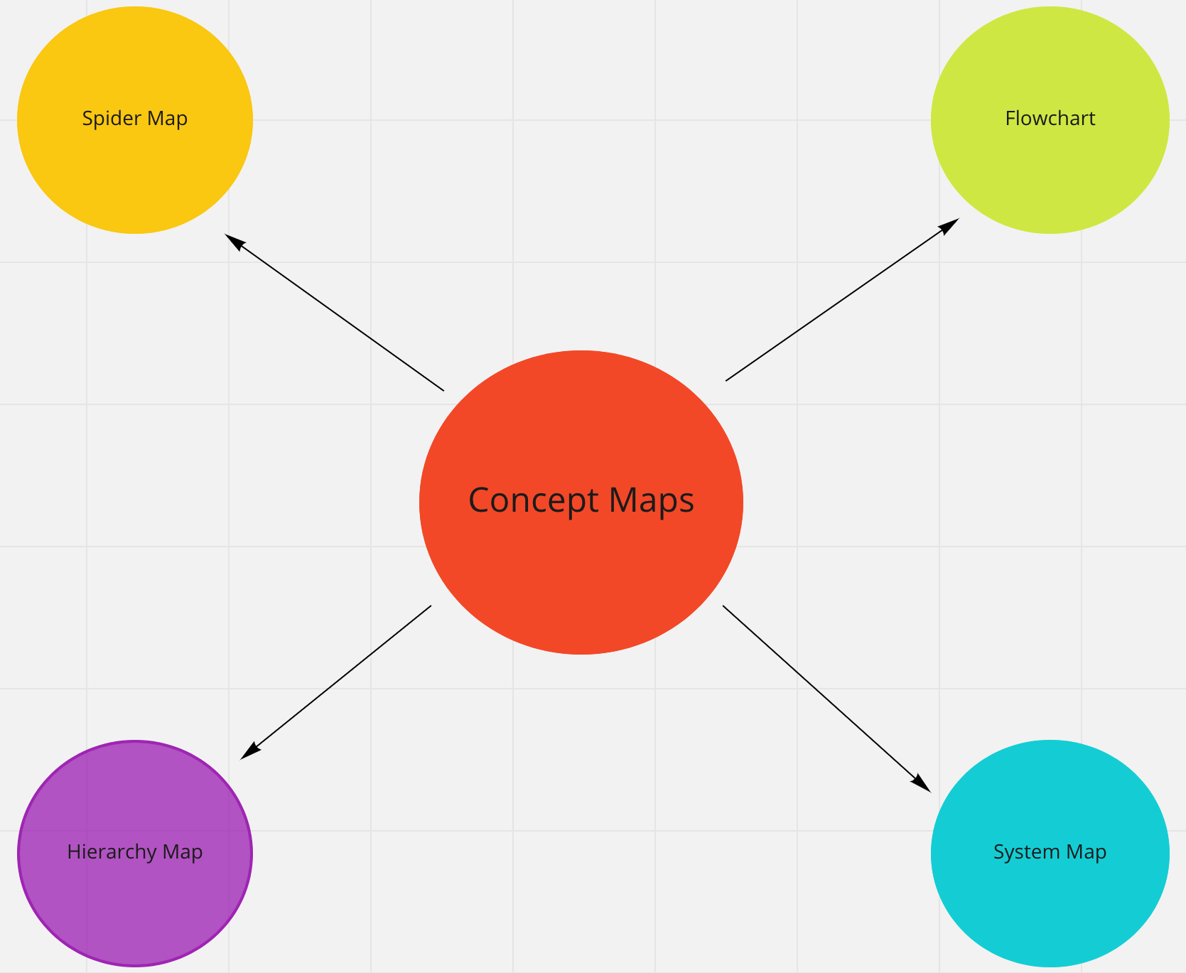
Note-Taking Strategies
Concepts Vocabulary
Formulas
Theorems
Contributors
What strategies do you use?
General
Take notes during synchronous and asynchronous instruction. (Consider doing it by hand!)
If available, annotate lecture slides or use AI to transcribe lectures or discussions.
Write down questions.
Use your own language(s) and multiple modes.
Check in with yourself. Review your notes periodically.
Common Types
Cornell Notes
Outlines
Concept Maps
Sentences
7 |
Notes:
cameron

Slide 8
Studying Resources
On-Campus Supports
Disability Access Services(https://disabilityaccessservices.northeastern.edu/)
ITC (https://international.northeastern.edu/itc/tutoring/)
Global Learner Support (https://gls.northeastern.edu/)
Writing Center (https://cssh.northeastern.edu/writingcenter/)
OSCCR (https://osccr.sites.northeastern.edu/)
Wyzant and Peer Tutoring (https://cps.northeastern.edu/current-students/tutoring-services/)
University Health and Counseling Services (https://uhcs.northeastern.edu/)
Friends and Classmates
Instructors and Teaching Staff / Academic Advising Staff
Activity
Let's explore some studying resources!
Browse one (or more) of these supports.
Share your own resources in the chat!
8 |
Notes:
cameron

Slide 9
Practicing Self-Compassion
Be kind to yourself. Everyone struggles with studying!
Anxious Thinking | Growth Mindset Reframing
"I always forget what I studied when I take tests—I must not be smart enough. I feel anxious." | "Anxiety is common! I can try new study strategies and use grounding techniques to calm myself."
"I feel overwhelmed and don't know where to start with major assignments." | "I can break big projects into smaller tasks and make a plan to move forward one step at a time."
"If I don't get a perfect grade, I've failed." | "Every assignment is a chance to learn something new. Grades are just one part of feedback."
"I tried asking for help before, but I still didn't get a good grade, so maybe it's hopeless." | "If things didn't work once, I can try a different strategy/resource next time. Progress takes time."
9 |

Slide 10
Recap
Reflect on your anxiety and use strategies to manage it.
Create a study plan, use studying strategies, and start early.
Take notes in ways most helpful to you.
Consult studying resources (like the ITC).
Practice self-compassion and reframe your thinking.
Any Questions?
10 |

Slide 11
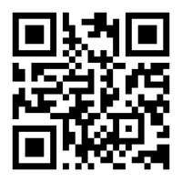
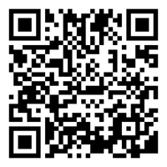
Next Steps
Book a 1-on-1 Tutoring Appointment!
View our tutors' schedules and book by using the QR code or by visiting https://web.penjiapp.com/communities/northeastern/itc/
Attend an Upcoming Workshop!
See our upcoming workshops by using the QR code or by visiting https://international.northeastern.edu/itc/workshops/
11 |
Notes:
Cameron

