Slide 1

Research Skills
International Tutoring Center
Supplemental Academic Services
Workshop Series
Cameron Sheehy, M.Ed.
...with the Library
1 |

Slide 2
Agenda
What is Research?
Presentation from the Library
Rhetorical Situation
Finding & Evaluating Sources Strategies
Presenting Sources Strategies
Research Resources
Practicing Self-Compassion
Recap & Next Steps
2 |

Slide 3

Disclaimer
This is an overview.
Each person is different with their own unique background, interests, needs, abilities, and context.
Even the same person can be different today than they were yesterday or will be tomorrow.
3 |

Slide 4
What is Research?
"Research is formalized curiosity. It is poking and prying with a purpose."
— Zora Neale Hurston, Dust Tracks on a Road
Presentation from the Library
Welcome, Christine Oka!
Library Instruction Coordinator & International Student Librarian
https://library.northeastern.edu/
4 |

Slide 5
Rhetorical Situation
Creator
Context
Prompts
Rhetorical Situation
→
Argument
Evidence
→
What is main idea, claim, or thesis?
Why did the creator choose these sources and not others?
→
Audience
Message
Genre
Bias
Does it follow the usual conventions?
What are your and the creator's assumptions? $?
5 |

Slide 6
Finding & Evaluating Sources Strategies
Search Techniques
(“word”) = included
(-word) = excluded
(word*) = all terms that start with word-
(e.g., words, wording)
(word1) AND (word2) =
results have both terms
(word1) OR (word2) =
results have either term
What to Ask
Who is the author?
Who is the intended audience?
What is the purpose?
When is it from?
How relevant is it to your topic/prompt?
How current is it?
How accurate is the information/evidence?
What are the biases (e.g., funding sources)?
More than the Text
Title + Abstract
Headings
Tables
Graphs
Figures
Bolded Words
Italic Words
Underlined Words
Highlighted Words
Activity
Let's practice evaluating sources strategies!
Take out any source. Use one or more of these strategies and see how it feels.
Then, we will return and discuss our experience.
6 |

Slide 7
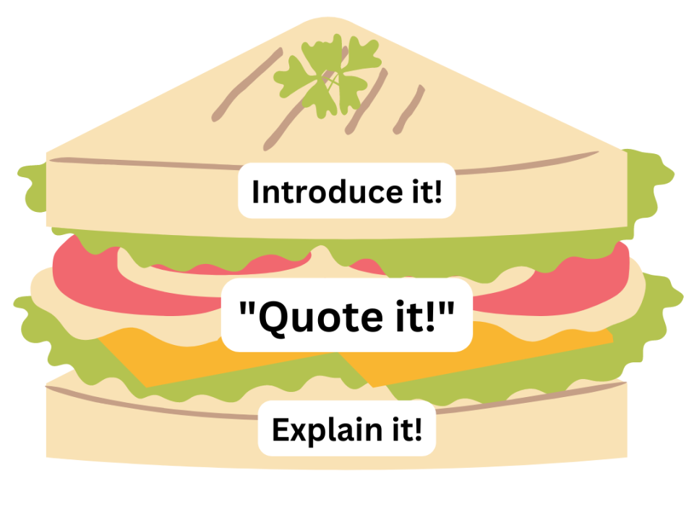
Presenting Sources Strategies
Summarizing vs.
Paraphrasing vs. Quoting
Summarizing: the main idea of the entire work in your own words
Paraphrasing: a specific idea from part of a work in your own words
Quoting: identical to original work in "…"
Quote Sandwich
Quotes and citations will look different by citation style (e.g., APA, MLA, Chicago).
1 or more sentences.
Staying Organized
Use citation managers (e.g., Zotero, Mendeley, EndNote).
Use AI Tools
(e.g., ResearchRabbit, Elicit, Scite.ai).
Keep a literature review matrix or use other note-taking strategies. Find more here.
Resources
Purdue OWL (https://owl.purdue.edu/owl/research_and_citation/using_research/quoting_paraphrasing_and_summarizing/index.html)
Manchester University Academic Phrasebank (https://www.phrasebank.manchester.ac.uk/)
Grammarly
Scribbr/QuillBot
Citation Tools
7 |

Slide 8
Research Resources
On-Campus Supports
Library (https://library.northeastern.edu/)
Disability Access Services(https://disabilityaccessservices.northeastern.edu/)
ITC (https://international.northeastern.edu/itc/tutoring/)
Global Learner Support (https://gls.northeastern.edu/)
Writing Center (https://cssh.northeastern.edu/writingcenter/)
Academic Integrity Policy (https://osccr.sites.northeastern.edu/academic-integrity-policy/)
Wyzant and Peer Tutoring (https://cps.northeastern.edu/current-students/tutoring-services/)
Friends and Classmates
Instructors and Teaching Staff (See how in our classroom culture workshop.)
Activity
Let's explore some studying resources!
Browse one (or more) of these supports.
Share your own resources in the chat!
8 |
Notes:
cameron

Slide 9
Practicing Self-Compassion
Be kind to yourself. Everyone struggles with research!
Anxious Thinking | Growth Mindset Reframing
"I don't know where to start looking for sources—it's too overwhelming." | "I can start with the library's database, ask a librarian for guidance, and use resources."
"I'm afraid I'll accidentally use a bad or unreliable source and lose points." | "I can evaluate sources by using information checklists and/or library guides for credibility."
"I'm not confident that I know how to use sources without plagiarizing." | "I can use citation tools, consult resources, and practice presenting sources for more confidence."
"I've never done this kind of research before—I'm not sure I can do it." | "Every student starts somewhere. Research is a skill I can build with practice and patience."
9 |

Slide 10
Recap
Find sources using the library (among other methods).
Evaluate the sources and their applicability to your research.
Present the sources accurately to avoid plagiarism.
Consult research resources.
Practice self-compassion and reframe your thinking.
Any Questions?
10 |

Slide 11
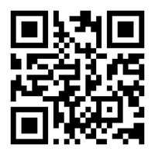
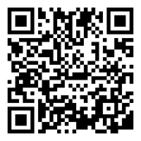
Next Steps
Book a 1-on-1 Tutoring Appointment!
View our tutors' schedules and book by using the QR code or by visiting https://web.penjiapp.com/communities/northeastern/itc/
Attend an Upcoming Workshop!
See our upcoming workshops by using the QR code or by visiting https://international.northeastern.edu/itc/workshops/
11 |
Notes:
Cameron

