Slide 1

Reading
International Tutoring Center
Supplemental Academic Services
Workshop Series
Cameron Sheehy, M.Ed.
1 |

Slide 2
Agenda
What is Reading?
Challenges to Reading
Rhetorical Situation
Academic Reading Strategies
Reading Resources
Practicing Self-Compassion
Recap & Next Steps
2 |

Slide 3
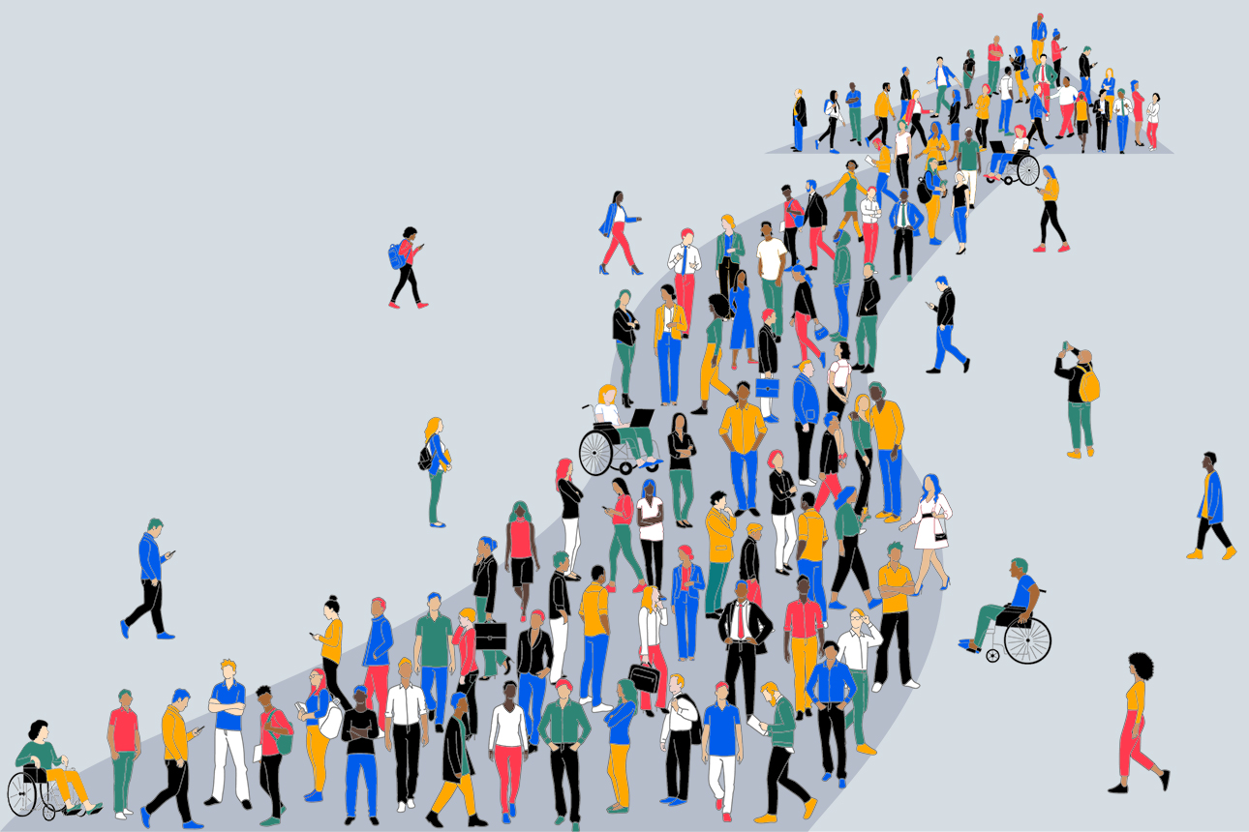
Disclaimer
This is an overview.
Each person is different with their own unique background, interests, needs, abilities, and context.
Even the same person can be different today than they were yesterday or will be tomorrow.
3 |

Slide 4
What is Reading?
"The more that you read, the more things you will know. The more that you learn, the more places you'll go.”
— Dr. Suess, I Can Read With My Eyes Shut!
What do we read?
Books
Journal Articles
Search Results
Texts/Emails
Social Media Posts
.
Prompts
Data
Novels
News
Reports
Why do we read?
To build critical thinking skills
To learn new ideas (for exams, lectures, research projects, etc.)
To become better writers
For fun!
4 |

Slide 5

Challenges to Reading
Disabilities or Different Abilities
Dyslexia
ADHD
Language Barriers
Lack of Motivation
Lack of Time
Reminder: Everyone's different!
5 |

Slide 6
Rhetorical Situation
Creator
Context
Rhetorical Situation
→
Argument
Evidence
→
What is main idea, claim, or thesis?
Why did the creator choose these sources and not others?
→
Audience
Message
Genre
Bias
Does it follow the usual conventions?
What are your and the creator's assumptions? $?
6 |

Slide 7
Academic Reading Strategies
Guided by Conventions
Each genre has conventions. Use them to your advantage.
Introduction
Literature Review
Methodology
Results/Findings
Discussion
Topic Sentences +
Concluding Sentences
More than the Text
Title + Abstract
Headings
Tables
Graphs
Figures
Bolded Words
Italic Words
Underlined Words
Highlighted Words
Retaining Information
Know your purpose before you read!
Connect, Question, Extend, Challenge
Survey, Question, Read, Recite, Review (SQ3R)
Outlines
Mindmapping
Forms / Spreadsheets
Activity #1
Let's practice these reading strategies!
Take out something you must read for class. Use one or more of these reading strategies and see how it feels.
Then, we will return and discuss our experience.
7 |

Slide 8
Reading Resources
On-Campus Supports
Disability Access Services (https://disabilityaccessservices.northeastern.edu/)
International Tutoring Center
(https://international.northeastern.edu/itc/tutoring/)
Global Learner Support (https://gls.northeastern.edu/)
Library (https://library.northeastern.edu/)
Friends, Family, Classmates, etc.
Off-Campus Supports
Local Libraries
Databases (e.g., Google Scholar)
Dictionaries & Thesauruses
Translators
Reading Accessibility Apps
Social Media (e.g., Reddit, Facebook, LinkedIn, Substack, Medium, etc.)
Use Artificial Intelligence!
Prompts: (1) What is the rhetorical situation? Genre? (2) Summarize.
(3) State in simpler terms.
Activity #2
Let's explore some reading resources!
Browse and/or use one (or more) of these supports.
Share your own reading resources in the chat!
8 |

Slide 9
Practicing Self-Compassion
Be kind to yourself. Everyone struggles with reading!
Anxious Thinking | Growth Mindset Reframing
"I don't understand this text—I must not be smart enough or know English well enough." | "This text is challenging, which means I'm learning. I can use strategies to break it down."
"There's too much reading—I'll never be able to keep up." | "I can plan my reading schedule in chunks and prioritize the most important sections."
"I can't remember anything I read." | "I can improve my retention by annotating, summarizing, and reviewing notes regularly."
"If I need help understanding the reading, it means I'm a failure." | "Using resources/supports is a smart strategy—discussing texts can deepen my understanding."
9 |

Slide 10
Recap
Think about your own motivations and purpose for reading.
Consider the rhetorical situation.
Use academic reading strategies.
Consult reading resources to support your understanding.
Practice self-compassion and reframe your thinking.
Any Questions?
10 |

Slide 11
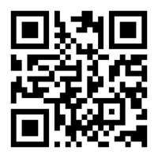
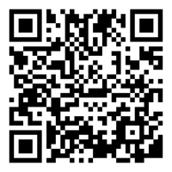
Next Steps
Book a 1-on-1 Tutoring Appointment!
View our tutors' schedules and book by using the QR code or by visiting https://web.penjiapp.com/communities/northeastern/itc/
Attend an Upcoming Workshop!
See our upcoming workshops by using the QR code or by visiting https://international.northeastern.edu/itc/workshops/
11 |
Notes:
Cameron

