Slide 1

Professional
Emails
International Tutoring Center
Supplemental Academic Services
Workshop Series
Crissy McMartin-Miller, PhD
Cameron Sheehy, M.Ed.
1 |

Slide 2
Agenda
Rhetorical Situation
(Beyond) the "Standard Email"
What do you think of this email?
Professional Emails Strategies
Professional Emails Resources
Practicing Self-Compassion
Recap & Next Steps
2 |
Notes:
Cameron

Slide 3

Disclaimer
This is an overview.
Each person is different with their own unique background, interests, needs, abilities, and context.
Even the same person can be different today than they were yesterday or will be tomorrow.
3 |
Notes:
Cameron

Slide 4


Activity #1: Write an Email
Write an email to your professor requesting a meeting to discuss an assignment. (No wrong way!)
Who is involved in this exchange?
Unmute or chat!
4 |
Notes:
Cameron (3 to 5 minutes)

Slide 5
Rhetorical Situation
Creator
Rhetorical Situation
Audience
Message
5 |
Notes:
Cameron

Slide 6
Activity #2: Write a Text Message
Write a text message to someone you’re close to making plans to do an activity.
I encourage you to use other languages and dialects, emojis, slang, abbreviations, etc.!
Compare your text message with your email. What’s similar? What’s different?
Unmute or chat!
6 |
Notes:
Cameron

Slide 7
Rhetorical Situation
North
American Colleges, Universities, and Companies
Standard-ized American English
Maybe not?
Creator
Context
Rhetorical Situation
Genre
Emails
vs.
Text Messages
Audience
Message
7 |
Notes:
Cameron

Slide 8
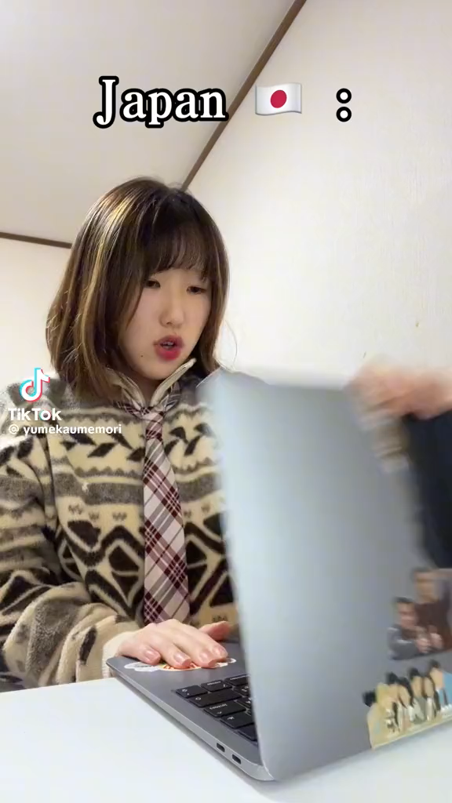
Contextual Differences
8 |
Notes:
Crissy

Slide 9
Contextual Differences
Email is common in North America. According to the Harvard Business Review, the typical professional…
Spends 28% of their workday reading and responding to emails.
Receives 120 emails per workday.
Older generations especially value email.
9 |
Notes:
Crissy

Slide 10
Beyond the "Standard" Email
Subject: Meeting Request
Dear Professor Smith,
I hope this email finds you well.
I am a student in your writing class, and I would like to request a meeting with you to discuss the upcoming paper.
I am available this Wednesday between 11am-1pm or this Friday after 10am. Please let me know if any of those times work for you or if you have other availability that would work better. Additionally, please let me know if there is anything I should do to prepare for the meeting.
Thank you and I look forward to meeting with you soon.
Best regards,
Firstname Lastname
Subject
Salutation
Introduction
Body
Conclusion
Closing
Signature
10 |
Notes:
Cameron

Slide 11
Beyond the "Standard" Email
Subject: Meeting Request
Dear Professor Smith,
I hope this email finds you well.
I am a student in your writing class, and I would like to request a meeting with you to discuss the upcoming paper.
I am available this Wednesday between 11am-1pm or this Friday after 10am. Please let me know if any of those times work for you or if you have other availability that would work better. Additionally, please let me know if there is anything I should do to prepare for the meeting.
Thank you and I look forward to meeting with you soon.
Best regards,
Firstname Lastname
11 |
Notes:
Crissy

Slide 12
Beyond the "Standard" Email
Subject: Meeting Request
Dear Professor Smith,
I hope this email finds you well.
I am a student in your writing class, and I would like to request a meeting with you to discuss the upcoming paper.
I am available this Wednesday between 11am-1pm or this Friday after 10am. Please let me know if any of those times work for you or if you have other availability that would work better. Additionally, please let me know if there is anything I should do to prepare for the meeting.
Thank you and I look forward to meeting with you soon.
Best regards,
Firstname Lastname
You could incorporate introductions and conclusions that reflect your linguistic and cultural diversity!
You could include how you want to be called or identified in the signature!
Any other suggestions?
12 |
Notes:
Cameron

Slide 13
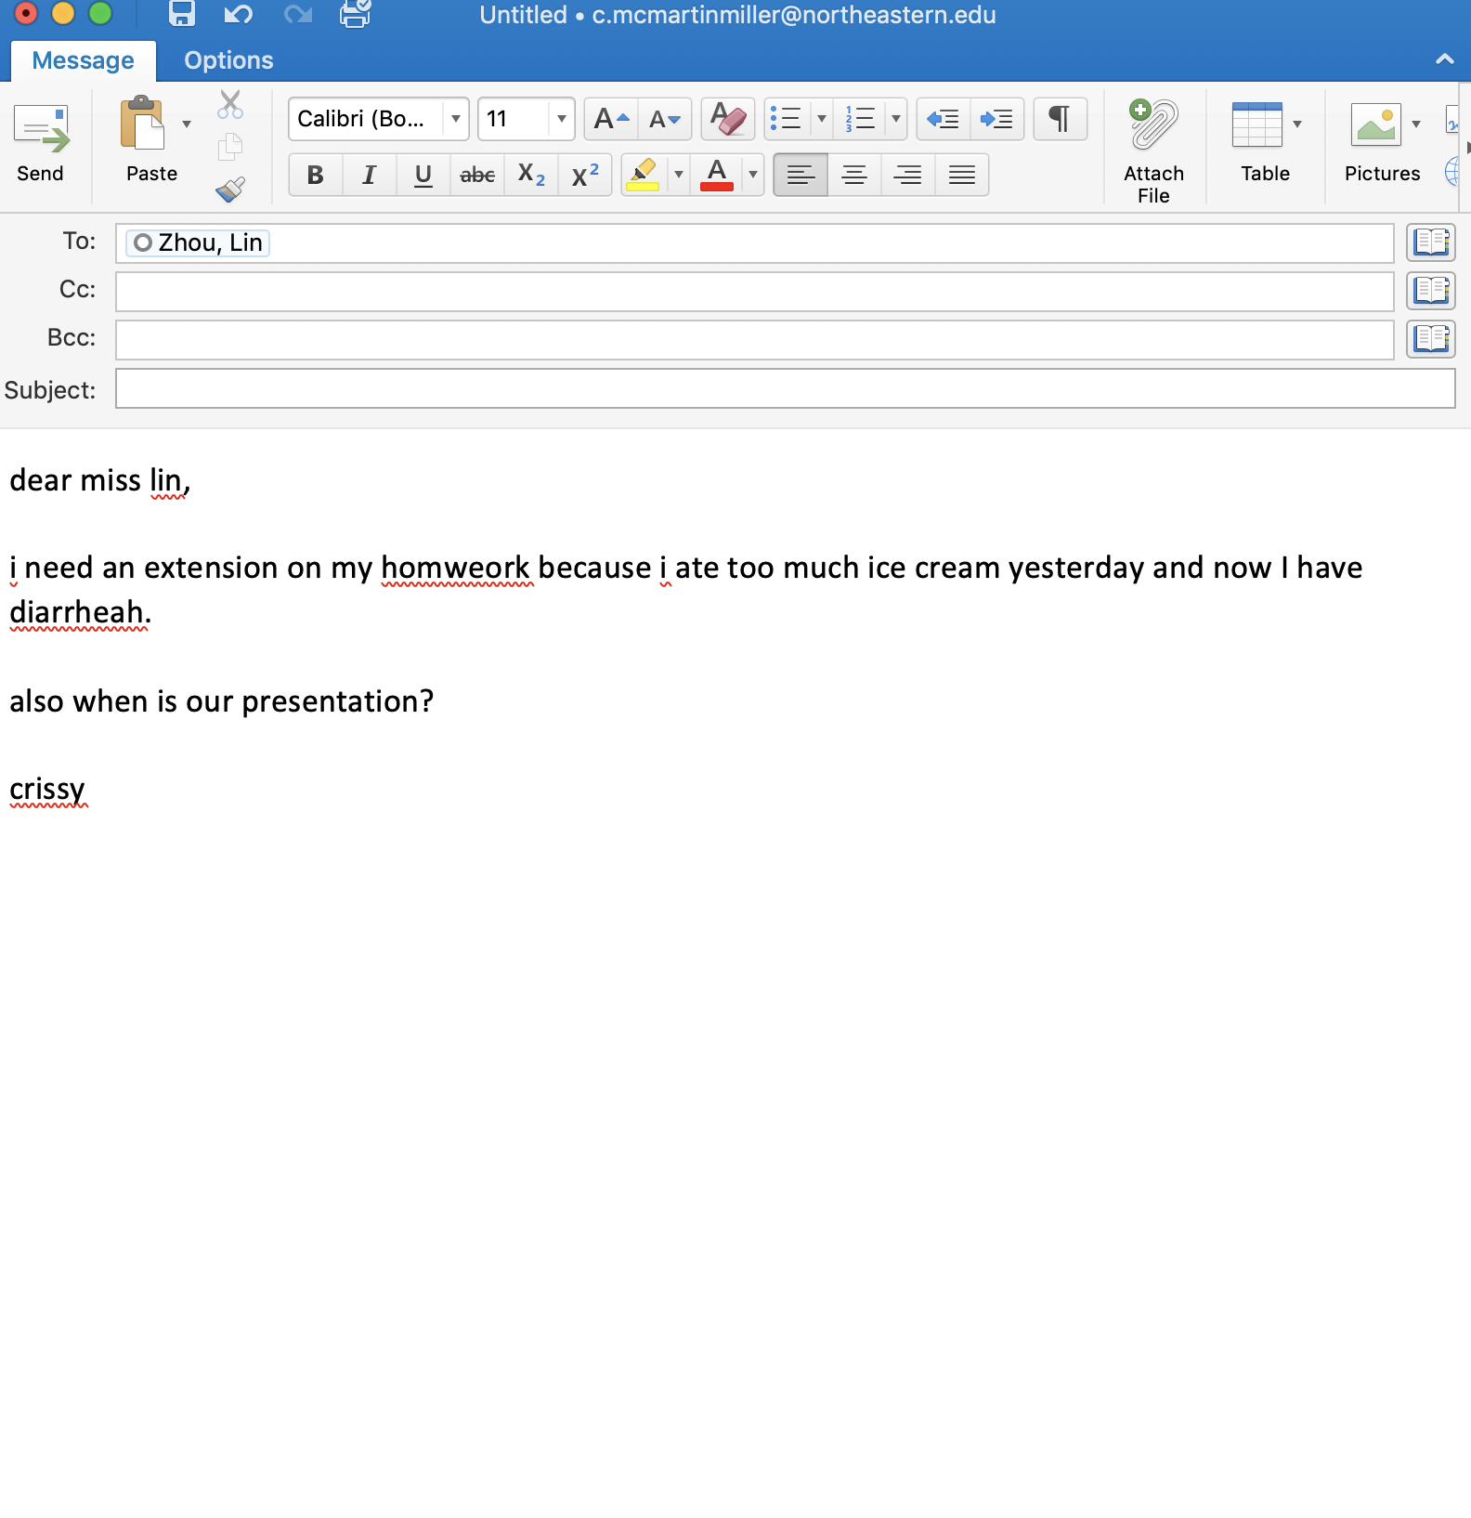
What do you think of this email?
13 |
Notes:
Crissy

Slide 14
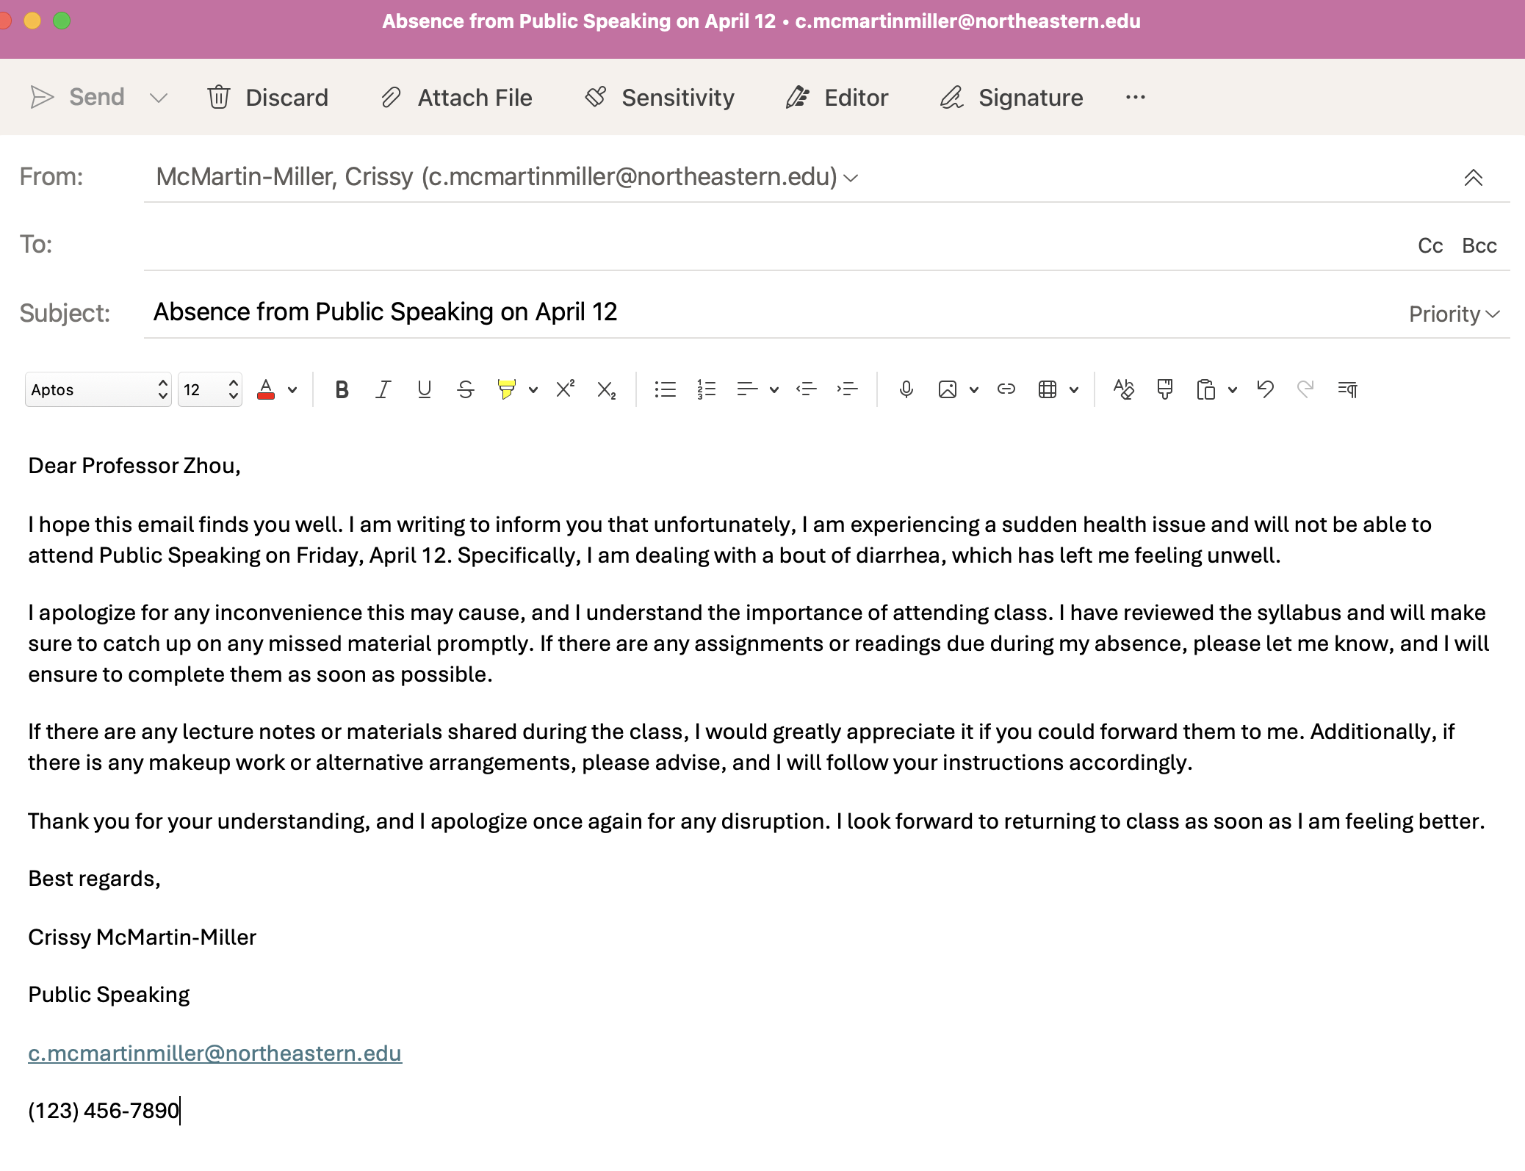
What do you think of this email?
14 |
Notes:
Crissy

Slide 15
Professional Emails Strategies
Common Types
Introductions
("Cold Email")
Follow Ups
Confirmations
Reminders
Thank Yous
Inquiries or Requests
*Familiarize yourself with types of emails and use templates.*
Common Etiquette
Set expectations for response timeframe, including auto-reply; otherwise, respond with 24-48 hours.
Let others tell you how to refer to them by their email's signature.
Subject line is usually a few words.
Note the difference:
cc, bcc, reply, reply all, forward
Other Considerations
Add a signature to your emails.
Follow an "inbox zero" method by keeping your inbox empty and organizing emails into folders.
Familiarize yourself with basic workspace emails (Outlook, Gmail).
Separate personal and professional.
Be empowered to add personality!
15 |
Notes:
Cameron

Slide 16
Professional Emails Resources
On-Campus Supports
Disability Access Services (https://disabilityaccessservices.northeastern.edu/)
International Tutoring Center
(https://international.northeastern.edu/itc/tutoring/)
Global Learner Support (https://gls.northeastern.edu/)
Writing Center (https://cssh.northeastern.edu/writingcenter/)
Friends, Family, Classmates, etc.
Off-Campus Supports
Dictionaries & Thesauruses
Translators
Grammarly, QuillBot, etc.
Manchester Academic Phrasebank
Indeed/LinkedIn Email Guides
Use Artificial Intelligence!
Prompts: You are an expert at writing professional emails. I am a [blank]. Write an email to [blank] about [blank]. Provide 3 examples at various tones with explanations.
Activity #3
Let's explore some writing resources!
Browse and/or use one (or more) of these supports.
Share your own writing resources in the chat!
16 |
Notes:
Crissy

Slide 17
Practicing Self-Compassion
Be kind to yourself. Everyone struggles with professional emails!
Anxious Thinking | Growth Mindset Reframing
"I don't understand what they said—I must not be smart enough or know English well enough." | "It was always good to ask for confirmation. Plus, I can use strategies and resources to support me."
"There's too many emails on top of everything else—I'll never be able to keep up." | "I can set expectations and schedule time for emails, prioritizing the most important ones first."
"I haven't gotten a response yet—I must have offended them or caused them to ignore me." | "They may not be responding for a number of reasons. I can always send a follow-up email."
"My emails feels too impersonal. I’m afraid they sounds too 'robotic' and unlike me." | "I can add personal elements throughout my emails to make them represent me."
17 |
Notes:
Cameron

Slide 18
Recap
Consider the rhetorical situation and cultural differences.
Use genre standards and other professional emails strategies throughout the writing process.
Consult professional emails resources to support you.
Practice self-compassion and reframe your thinking.
Any Questions?
18 |
Notes:
Cameron

Slide 19
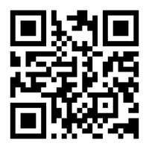
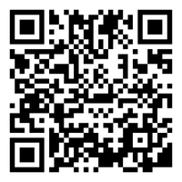
Next Steps
Book a 1-on-1 Tutoring Appointment!
View our tutors' schedules and book by using the QR code or by visiting https://web.penjiapp.com/communities/northeastern/itc/
Attend an Upcoming Workshop!
See our upcoming workshops by using the QR code or by visiting https://international.northeastern.edu/itc/workshops/
19 |
Notes:
Cameron

