Slide 1

Conversation
International Tutoring Center
Supplemental Academic Services
Workshop Series
Cameron Sheehy, M.Ed.
1 |

Slide 2
Agenda
What is Small Talk?
Challenges to Small Talk
Small Talk Strategies
Finding Events
Practicing Self-Compassion
Recap & Next Steps
2 |

Slide 3
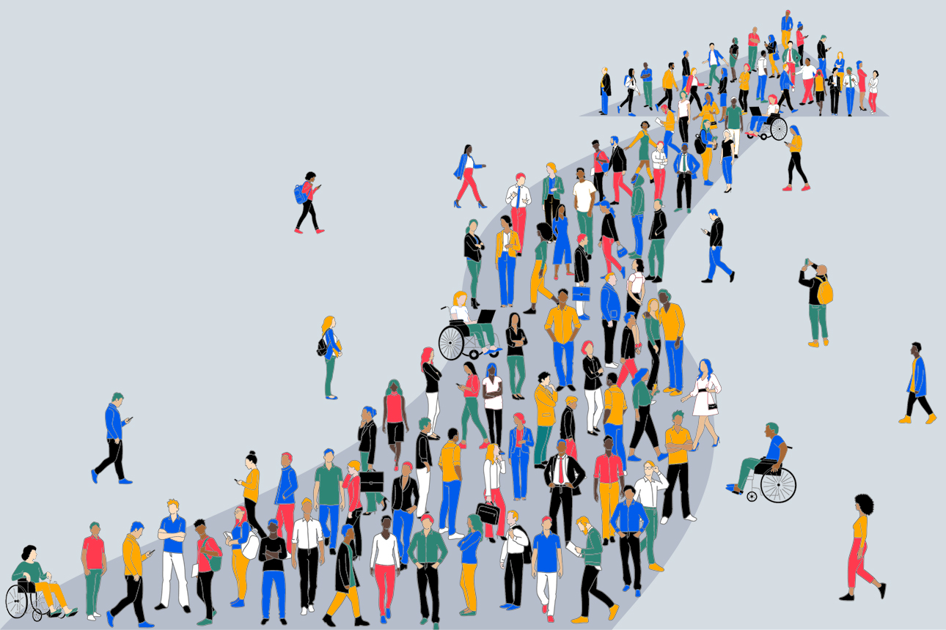
Disclaimer
This is an overview.
Each person is different with their own unique background, interests, needs, abilities, and context.
Even the same person can be different today than they were yesterday or will be tomorrow.
3 |

Slide 4
What is Small Talk?
"conversation about things that are not important, often between people who do not know each other well”
— Cambridge English Dictionary
Why is small talk useful?
It can create opportunities for academic, professional, and/or personal networking.
It can help us start to build toward deeper relationships with others.
When does small talk happen?
Before / After Classes or Meetings
Waiting in Line for Something
Going Somewhere
Career Fairs and Networking
Social Gatherings or Other Events
4 |

Slide 5

Challenges to Small Talk
Feeling Trapped or Forced
Anxiety
  Social Expectations
  Cultural Expectations
  Different Abilities
Finding Topics
What to Do Next
How to Leave
Reminder: Everyone's different!
5 |

Slide 6
Small Talk Strategies
Reveal something about yourself
Explore the other person's interests
Ask more open-ended questions
Consciously listen (*will vary by person*)
Highlight your similarities/commonalities
What to Do Next
reflect on small talk
EITHER
ask for phone number, social media, or email
invite to an event
OR
simply end small talk respectfully
Activity #1
Let's practice!
Enter the breakout room, and strike up a conversation.
Let each person try starting and ending the conversation.
Set a small talk goal.
Practice with AI.
Finding Topics
With Strangers
Hobbies
Entertainment
Food
Environment
With Friends
Family
Occupation
Recreation
Dreams
*Note*
Approaches will depend on context.
How to Leave
offer a reason to leave (if necessary)
end on a positive note
6 |

Slide 7
Finding Events
Local Events
Eventbrite
The Boston Calendar (for Boston)
Government Websites
Library Websites
Museum Websites
Google Searches
Local Newsletters
Social Media (e.g., Instagram, TikTok, Reddit, Facebook, LinkedIn, etc.)
On-Campus Events
Northeastern Calendar (https://calendar.northeastern.edu/)
Clubs and Student Organizations
(https://engage.northeastern.edu/)
Social Media (e.g., Instagram, TikTok, Reddit, Facebook, LinkedIn, etc.)
Activity #2
Let's find some events!
Browse one (or more) of these suggestions and find an event you're interested in.
Pick one you'd be fine going to by yourself, but still try and invite someone to go!
7 |

Slide 8
Practicing Self-Compassion
Be kind to yourself. Everyone struggles with small talk!
Anxious Thinking | Growth Mindset Reframing
"I never know what to say, so I just avoid small talk." | "I can start with simple questions like 'How's your day going?' Small talk doesn’t have to be deep."
"People will think I’m awkward if I start a conversation." | "Most people appreciate when someone else breaks the ice. It shows friendliness."
"If I mess up what I say, they'll think I'm weird or judge me by my accent." | "What matters is showing interest, not being perfect. Someone's judgement is more a reflection on them than it is on you."
"I need to be interesting to talk to people." | "Asking about others is often more engaging. Plus, everyone is interesting in their own way!"
8 |

Slide 9
Recap
Reflect on your challenges to small talk.
Set a personal goal for small talk and follow it. (Be flexible!)
Start a (context-appropriate) conversation and practice.
Decide what to do next then leave the conversation.
Practice self-compassion and reframe your thinking.
Any Questions?
9 |

Slide 10
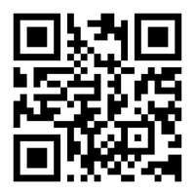
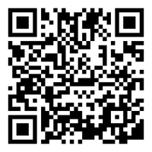
Next Steps
Book a 1-on-1 Tutoring Appointment!
View our tutors' schedules and book by using the QR code or by visiting https://web.penjiapp.com/communities/northeastern/itc/
Attend an Upcoming Workshop!
See our upcoming workshops by using the QR code or by visiting https://international.northeastern.edu/itc/workshops/
10 |
Notes:
Cameron

