Slide 1

Career Preparation
International Tutoring Center
Supplemental Academic Services
Workshop Series
Cameron Sheehy, M.Ed.
...with Employer Engagement and Career Design

Slide 2
Agenda
How do you prepare for your career?
Figure out what you want to do...
Find out where to apply...
Apply to jobs, coops, and more...
Practicing Self-Compassion
Recap & Next Steps
2 |

Slide 3

Disclaimer
This is an overview.
Each person is different with their own unique background, interests, needs, abilities, and context.
Even the same person can be different today than they were yesterday or will be tomorrow.

Slide 4
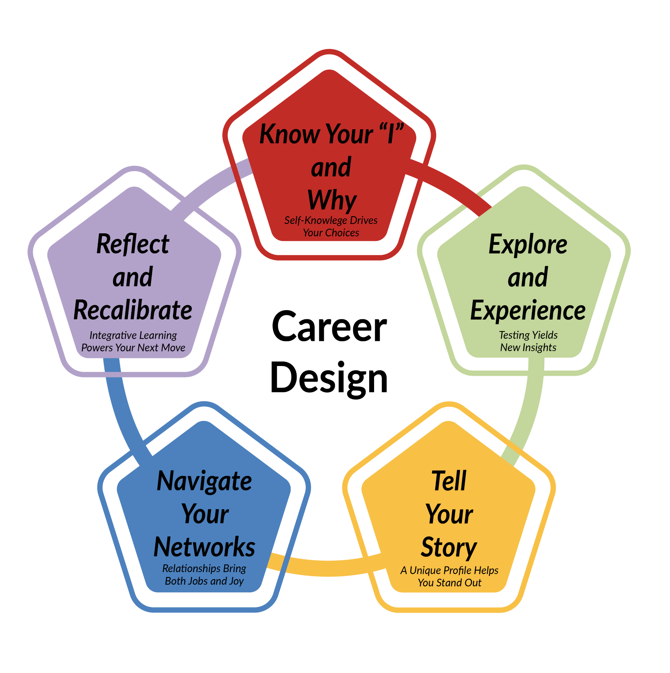
How do you prepare for your career?
Figure out what you want to do
Build experience via education, experiential and academic projects, employment, training, and more
Find out where to apply
Apply to jobs, co-ops, and more
4 |

Slide 5
Figure out what you want to do...
Career Guides, Forums, and Blog Articles
- EECD's Career Guides (https://careers.northeastern.edu/group/career-exploration/)
- Reddit
(https://www.reddit.com/r/careerguidance/)
- Glassdoor Bowls
Google: jobs related to [skill/hobby/interest]
Artificial Intelligence
Example Prompt for Claude, ChatGPT, etc.:
"What are some jobs related to [skill/hobby/interest]? Create a table with 20 possible types of jobs, including average weekly hours, beginning and median salary, and lifestyle considerations."
Career Assessments
Skills Driver
TruMotivate
Gallup Strengths
StrengthsProfile
Strong Interests Inventory
SparkPath
Values Card Sorts
Princeton Review
(https://www.princetonreview.com/quiz/career-quiz)
CollegeBoard
(https://bigfuture.collegeboard.org/career-search/career-quiz)
Activity #1
Let's figure what we want to do!
Reflect on what is most important to you in your career. Explore ≥1 of these resources.
Then, we will return and discuss our experience.

Slide 6
Find out where to apply...
Job Dashboards
LinkedIn
Handshake
Indeed
GlassDoor
ZipRecruiter
Google Jobs Dashboard
University/Government
NUWorks
(https://careers.northeastern.edu/students/nuworks/)
Advanced Search
Considerations:
Location/Lifestyle
Job Type/Mobility
Salary Range
Deadline
Required Materials
Search Techniques:
"word" = included
-word = excluded
AND / OR / NOT
Networking
Career Fairs and Events
NU Talent Connect
EventBrite
Student Organizations (https://neu.campuslabs.com/engage/events)
Connect on LinkedIn for Informational Interviews
Northeastern > Alumni > Search Techniques
Activity #2
Let's try messaging someone on LinkedIn for an informational interview!
Follow along with me as we search for and message someone to talk with them about their work experience.

Slide 7
Apply to jobs, coops, internships, and more...
Application Materials
Average Lengths:
Resumes: 1-2 page
CVs: 2+ pages
Cover Letters: 1 page
1. Use Google's XYZ Resume Formula (Outcome/Skill Focus)
2. Build a Master Template for Revision
3. Use AI to Tailor from Job Description!!!
Interviewing
Elevator Pitch
Study Their Questions
Study Their Culture
Prepare Your Questions
STAR Method:
Situation > Task > Action > Results
When to Follow Up?
- next day thank you
- 1 week after if nothing
Show Strengths as an International Applicant
Don't bring up your OPT needs too soon. Be direct and honest when asked.
Focus on your assets:
multilingualism, social and cultural awareness, adaptability/flexibility.
Contextualize experiences for your intended audience.
On-Campus Supports
Employer Engagement and Career Design
Coop Advisors
ITC
Writing Center
GLS
Library
(https://subjectguides.lib.neu.edu/human_services/co-op_to_career)
Office of Global Services (OGS)!

Slide 8
Practicing Self-Compassion
Be kind to yourself. Everyone struggles with career preparation!
Anxious Thinking | Growth Mindset Reframing
"No one will hire me because I need visa sponsorship." | "Some employers may not offer sponsorship, but others value my skills and global perspective."
"I don't have North American work experience, so I'm already behind." | "Every professional starts somewhere. My unique background gives me a fresh perspective to offer."
"My accent will make me sound less professional." | "My accent reflects my multilingual ability, an asset in a global workforce. Everyone has one."
"The job market is too competitive right now. I'll never stand out." | "I can stand out by showing how my experience adds value. Plus, everyone's on their own path!"

Slide 9
Recap
Reflect on your own career preparation and set goals.
Come to Career Design!
Figure out what you want to do through research.
Find out where to apply and create materials.
Consult career preparation resources (like the ITC).
Practice self-compassion and reframe your thinking.
Any Questions?

Slide 10
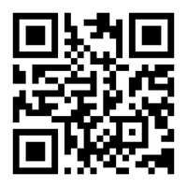
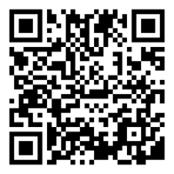
Next Steps
Book a 1-on-1 Tutoring Appointment!
View our tutors' schedules and book by using the QR code or by visiting https://web.penjiapp.com/communities/northeastern/itc/
Attend an Upcoming Workshop!
See our upcoming workshops by using the QR code or by visiting https://international.northeastern.edu/itc/workshops/
Notes:
Cameron

